Slide 1



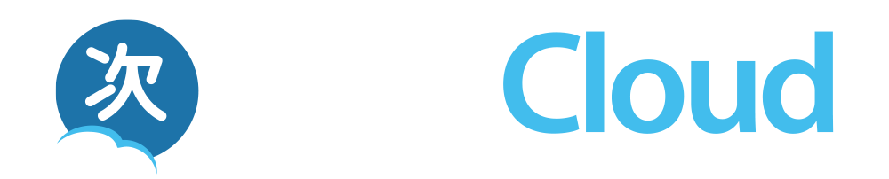
Learning Management Systems, Educational App Stores, Repositories, and Analytics - An Ecosystem Approach
Dr. Charles Severance
University of Michigan School of Information
www.tsugi.org www.tsugicloud.org
https://www.slideshare.net/csev

Slide 2

100% Open Ecosystem
Open LMS - Sakai
Open App Store - Tsugi
Open Analytics – OpenLRW / Open LRS
Notes:
Focus - A suite of open source solutions, connected together using industry standards
Sakai - Evolves towards a next-generation LMS
Tsugi – The first cross-platform Education App Store
Build - Analytics solutions across the ecosystem

Slide 3
Apereo Ecosystem
Focus -業界標準で相互に接続する一連のオープンソースソリューション
Sakai - 次世代学習管理システムへと進化
Tsugi – 初のクロスプラットフォームの教育用App ストア
Build - エコシステム全体の分析ソリューション

Slide 4

Sakai Principles
Lightness: today’s 2.9 million lines of code is being intentionally reduced
Usability: including a simple, easy-to-use, globally accessible interface
Choices: in templates, layouts, and tool selection
Interoperability: using our influence to build better integration standards
API coverage: including all services with externally accessible APIs
Cooperation: helping others to implement and use open standards
Analytics: more data, both from the LMS itself and from integrated tools

Slide 5
Sakai 基本原則
Lightness: 現在290万行のコードを意図的に縮小中
Usability: シンプルで使いやすいグローバルにアクセス可能な
インターフェース
Choices: テンプレート、レイアウト、およびツールの選択肢
Interoperability: Sakaiの影響力を利用してより良い統合標準を構築
API coverage: 外部からアクセス可能なすべてのサービスAPIs
Cooperation: 人々がオープンスタンダードを実装し使用する支援
Analytics: LMS自体と統合ツールの双方から、より多くのデータを
Notes:
Lightness: today’s 2.9 million lines of code is being intentionally reduced
Usability: including a simple, easy-to-use, globally accessible interface
Choices: in templates, layouts, and tool selection
Interoperability: using our influence to build better integration standards
API coverage: including all services with externally accessible APIs
Cooperation: helping others to implement and use open standards
Analytics: more data, both from the LMS itself and from integrated tools

Slide 6

The Standards Are Ready to Form an Ecosystem
Notes:
It turns out things are lining up.

Slide 7
DEEP LINKING®
CC®
LTI®
IMS DEEP LINKING® FILLS THE GAPS AND MAKES CONNECTIONS BETWEEN IMS LEARNING TOOLS INTEROPERABILITY® AND IMS COMMON CARTRIDGE®.
LTI®, CC®, and Deep Linking® are trademarks of IMS Global Learning Consortium, Inc. (www.imsglobal.org)

Slide 8
DEEP LINKING®
CC®
LTI®
IMS DEEP LINKING® は、IMS学習ツール相互運用性®と IMS共通カートリッジ®を接続し、ギャップを埋めます。
LTI®, CC®, and Deep Linking® are trademarks of IMS Global Learning Consortium, Inc. (www.imsglobal.org)
Notes:
IMS DEEP LINKING® FILLS THE GAPS AND MAKES CONNECTIONS BETWEEN IMS LEARNING TOOLS INTEROPERABILITY® AND IMS COMMON CARTRIDGE®.

Slide 9


Blackboard
Complete: LTI 1.1, Common Cartridge, Deep Linking
In Progress: Membership and Gradebook
Canvas
Complete: LTI 1.1, Common Cartridge, Deep Linking
In Progress: Membership and Gradebook
Desire2Learn
Complete: LTI 1.1, Common Cartridge, Deep Linking
In Progress: Membership and Gradebook
Sakai
Complete: LTI 1.1, Common Cartridge, Deep Linking
In Progress: Membership and Gradebook
Notes:
IMS Learning Tools Interoperability (which the Sakai Project started in 2004). is what laid the foundation for this market disruption. I have been putting slides like this up for years. There has never been better alignment amongst the major players in terms of support for standards.

Slide 10
A Standards-Based Educational App Store

Slide 11
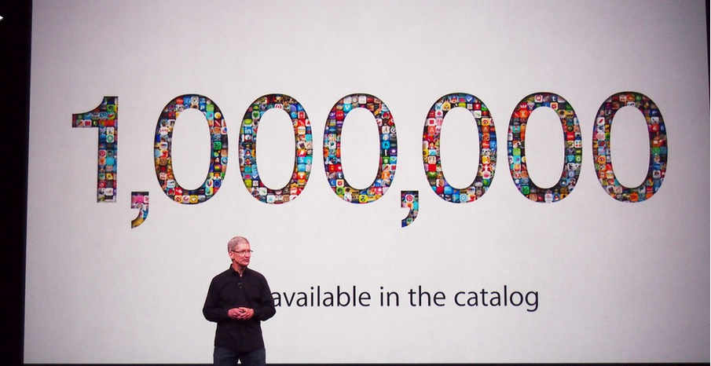
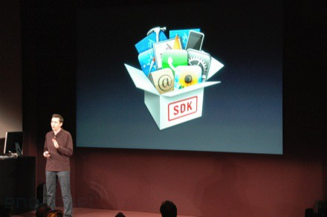
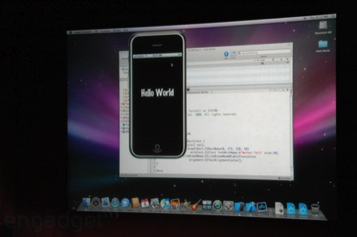
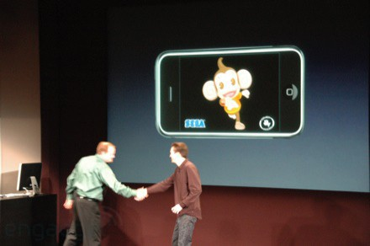
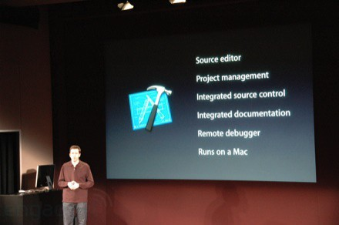
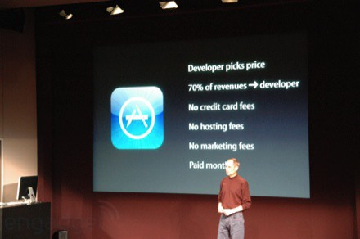
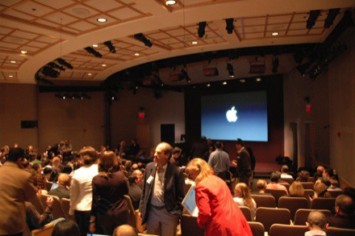
March 6, 2008 iPhone SDK Press Conference

Slide 12
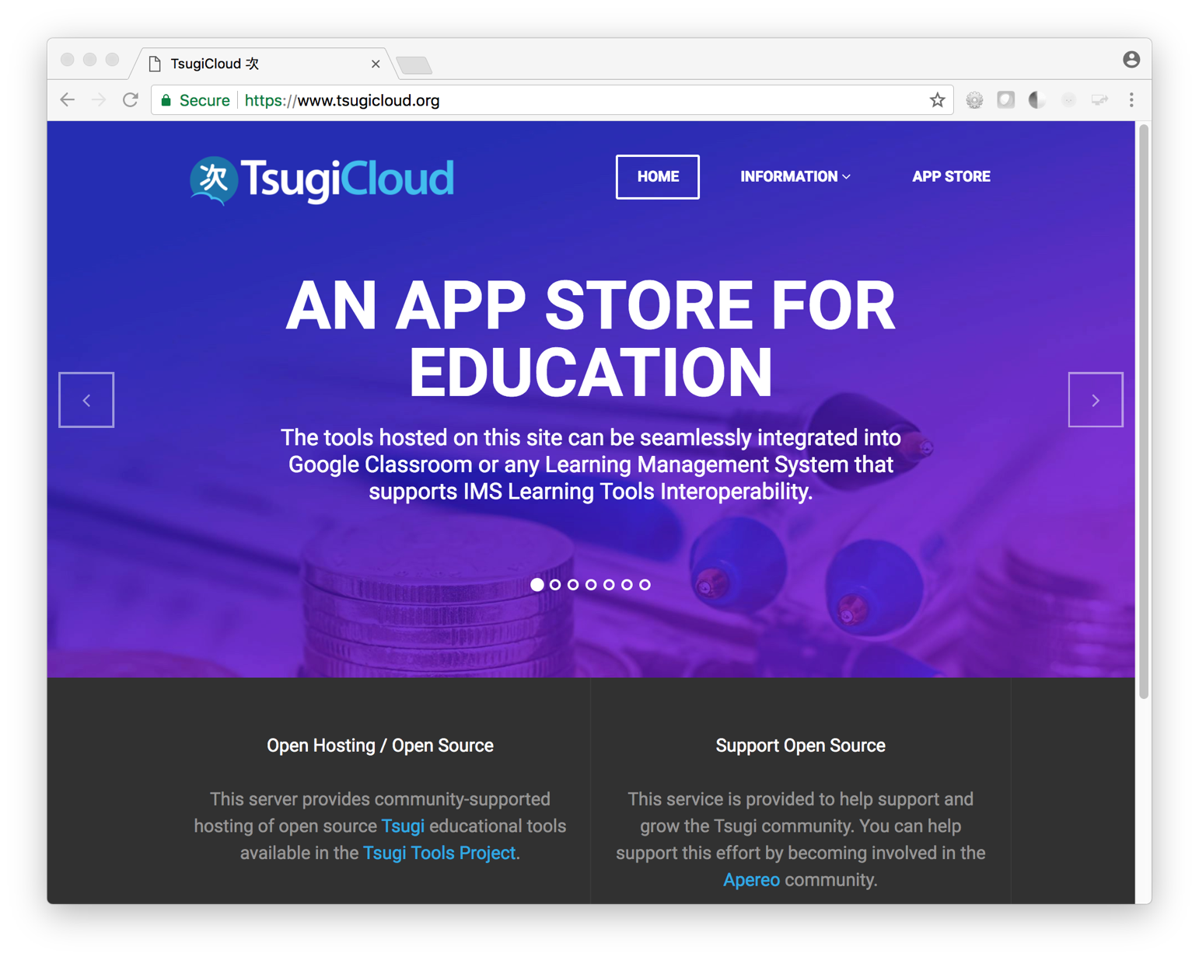
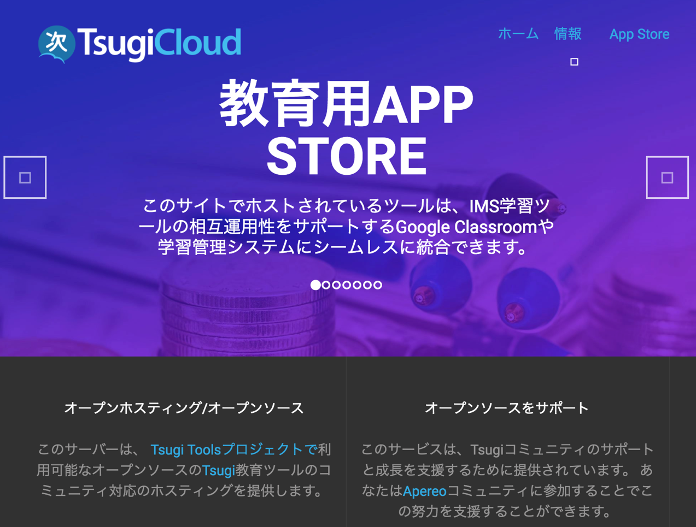

Slide 13
Free cloud-hosted Apereo Tsugi tools
IMS Integrations + Google Classroom
A teacher can use it in a single course
Campus IT staff can install in an LMS in all courses
Developers can build and contribute apps (paid)
Commercial cloud hosting is coming soon…

Slide 14
クラウドベースの無料 Apereo Tsugi ツール
IMSインテグレーション + Google クラスルーム
教師は1つのコース内でも使用可能
キャンパスITスタッフは、全コースで
LMSにインストールできる
デベロッパーはアプリを構築して貢献（有料）
商用クラウドホスティングは近未来に実現...
Notes:
Free cloud-hosted Apereo Tsugi tools
IMS Integrations + Google Classroom
A teacher can use it in a single course
Campus IT staff can install in an LMS in all courses
Developers can build and contribute apps (paid)
Commercial cloud hosting is coming soon…

Slide 15
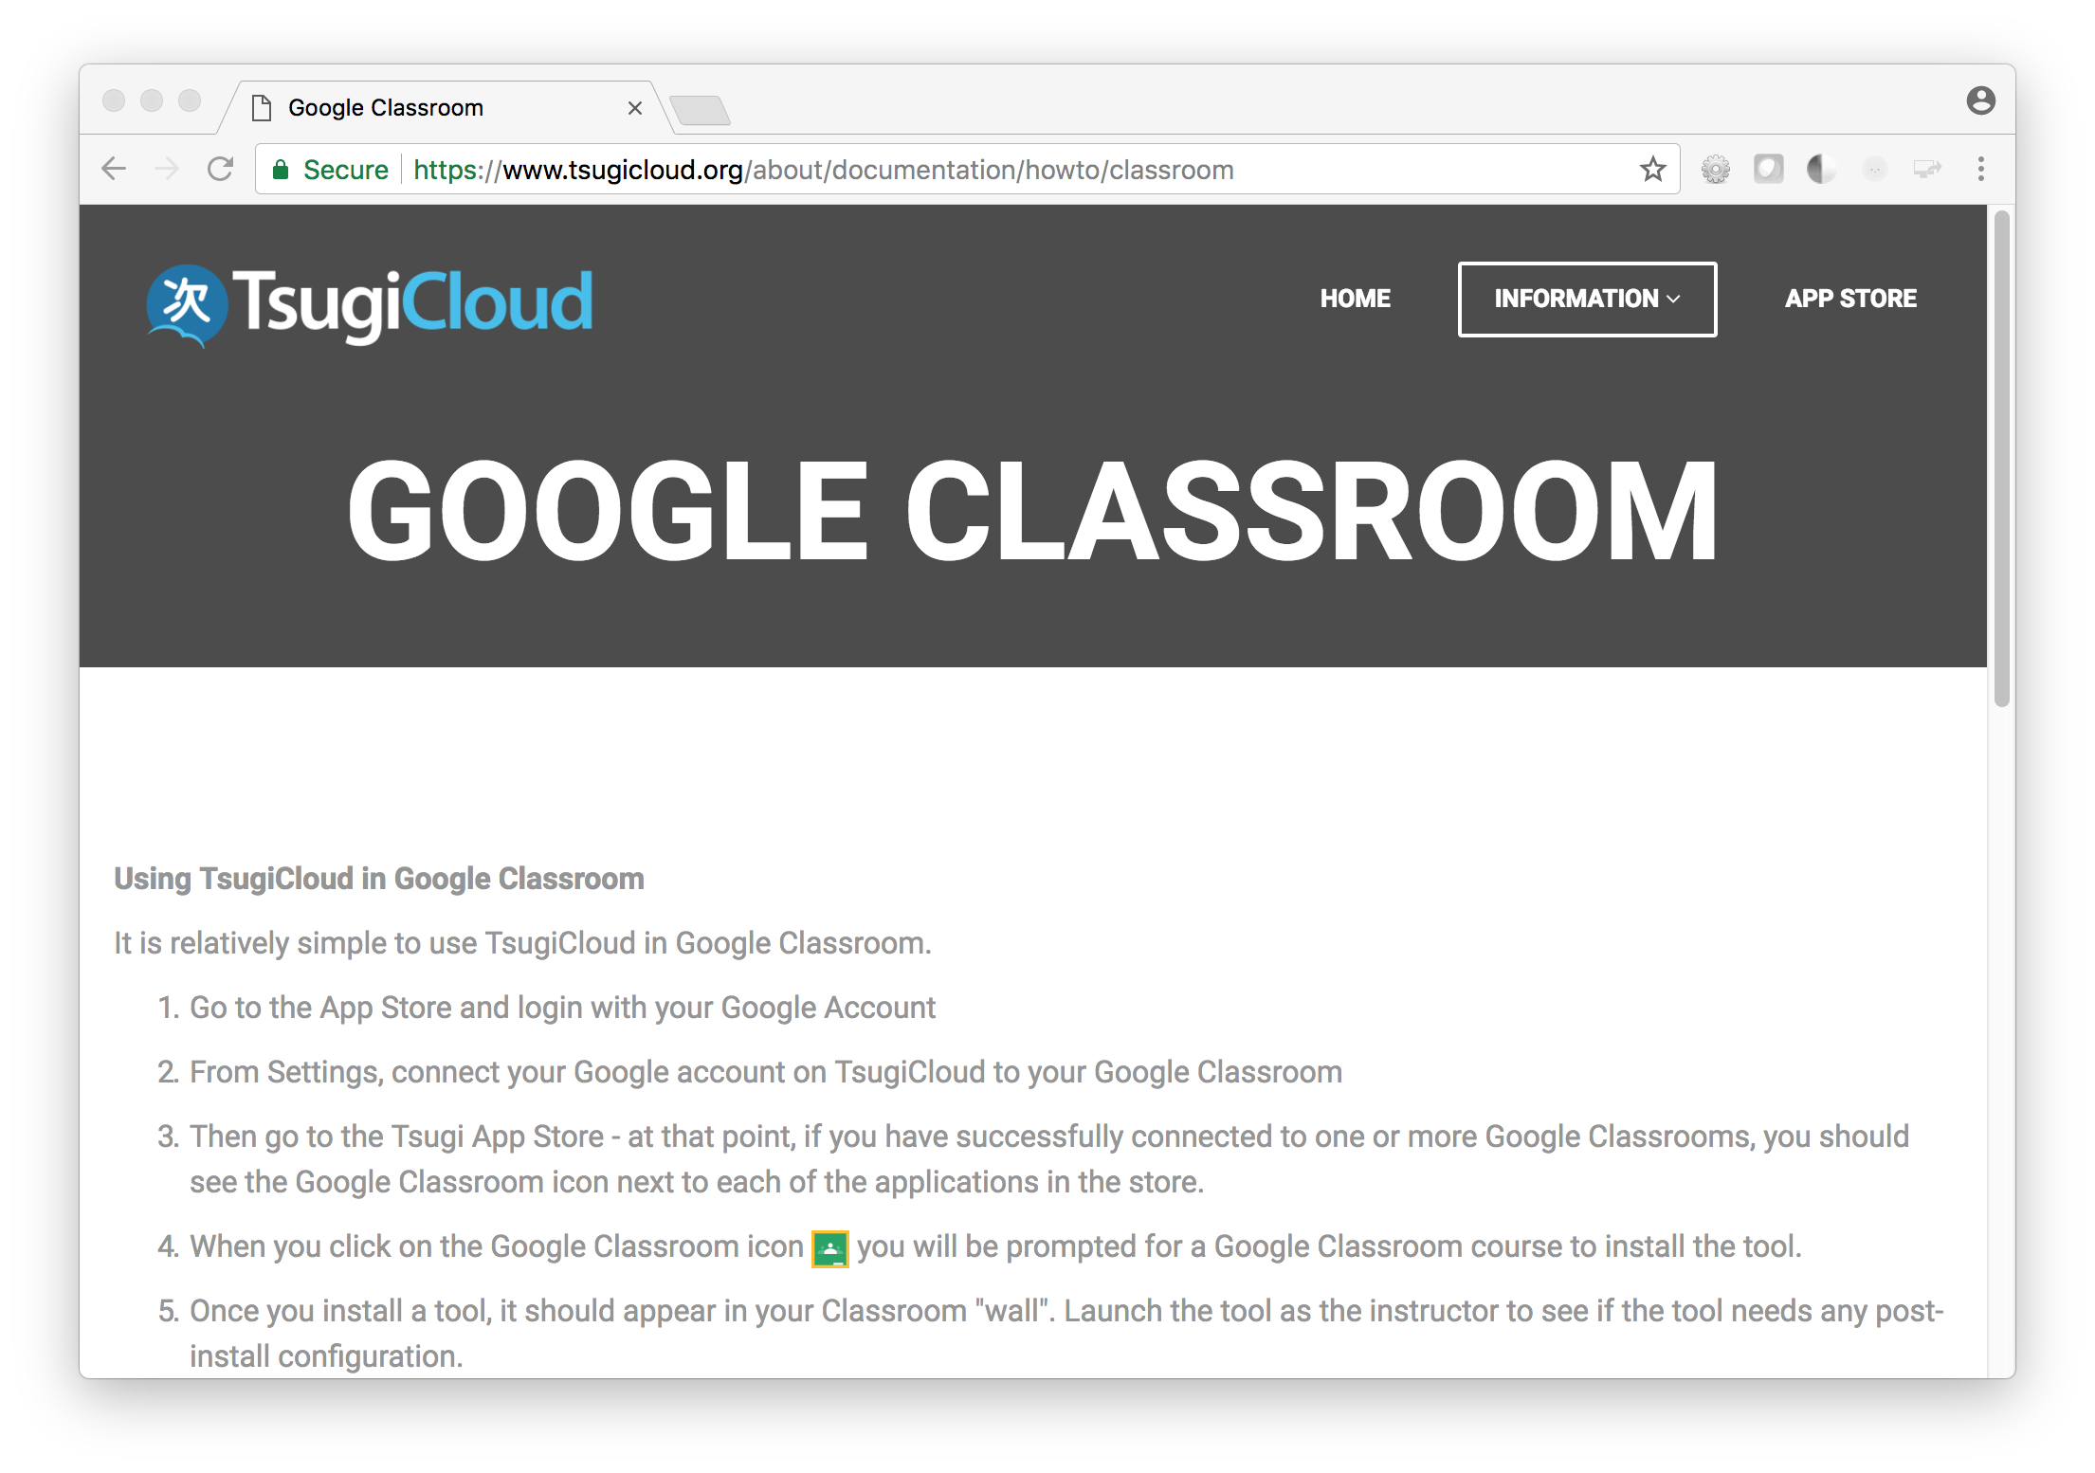
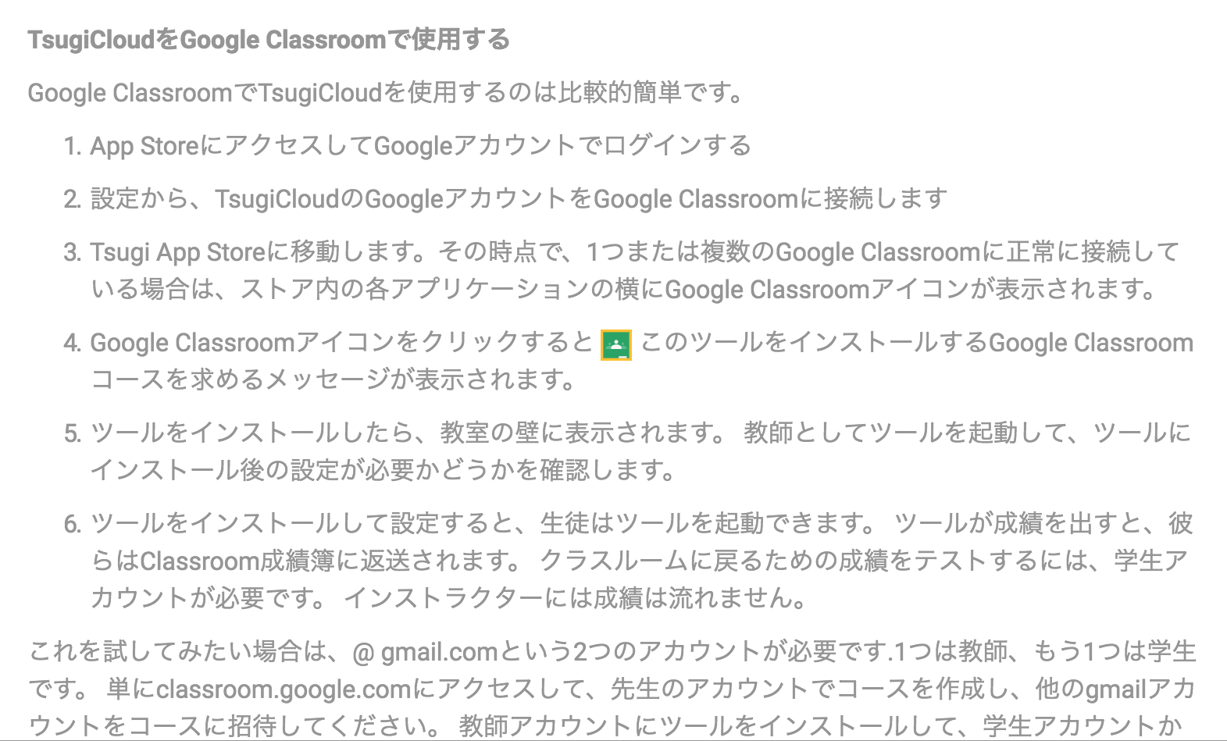

Slide 16
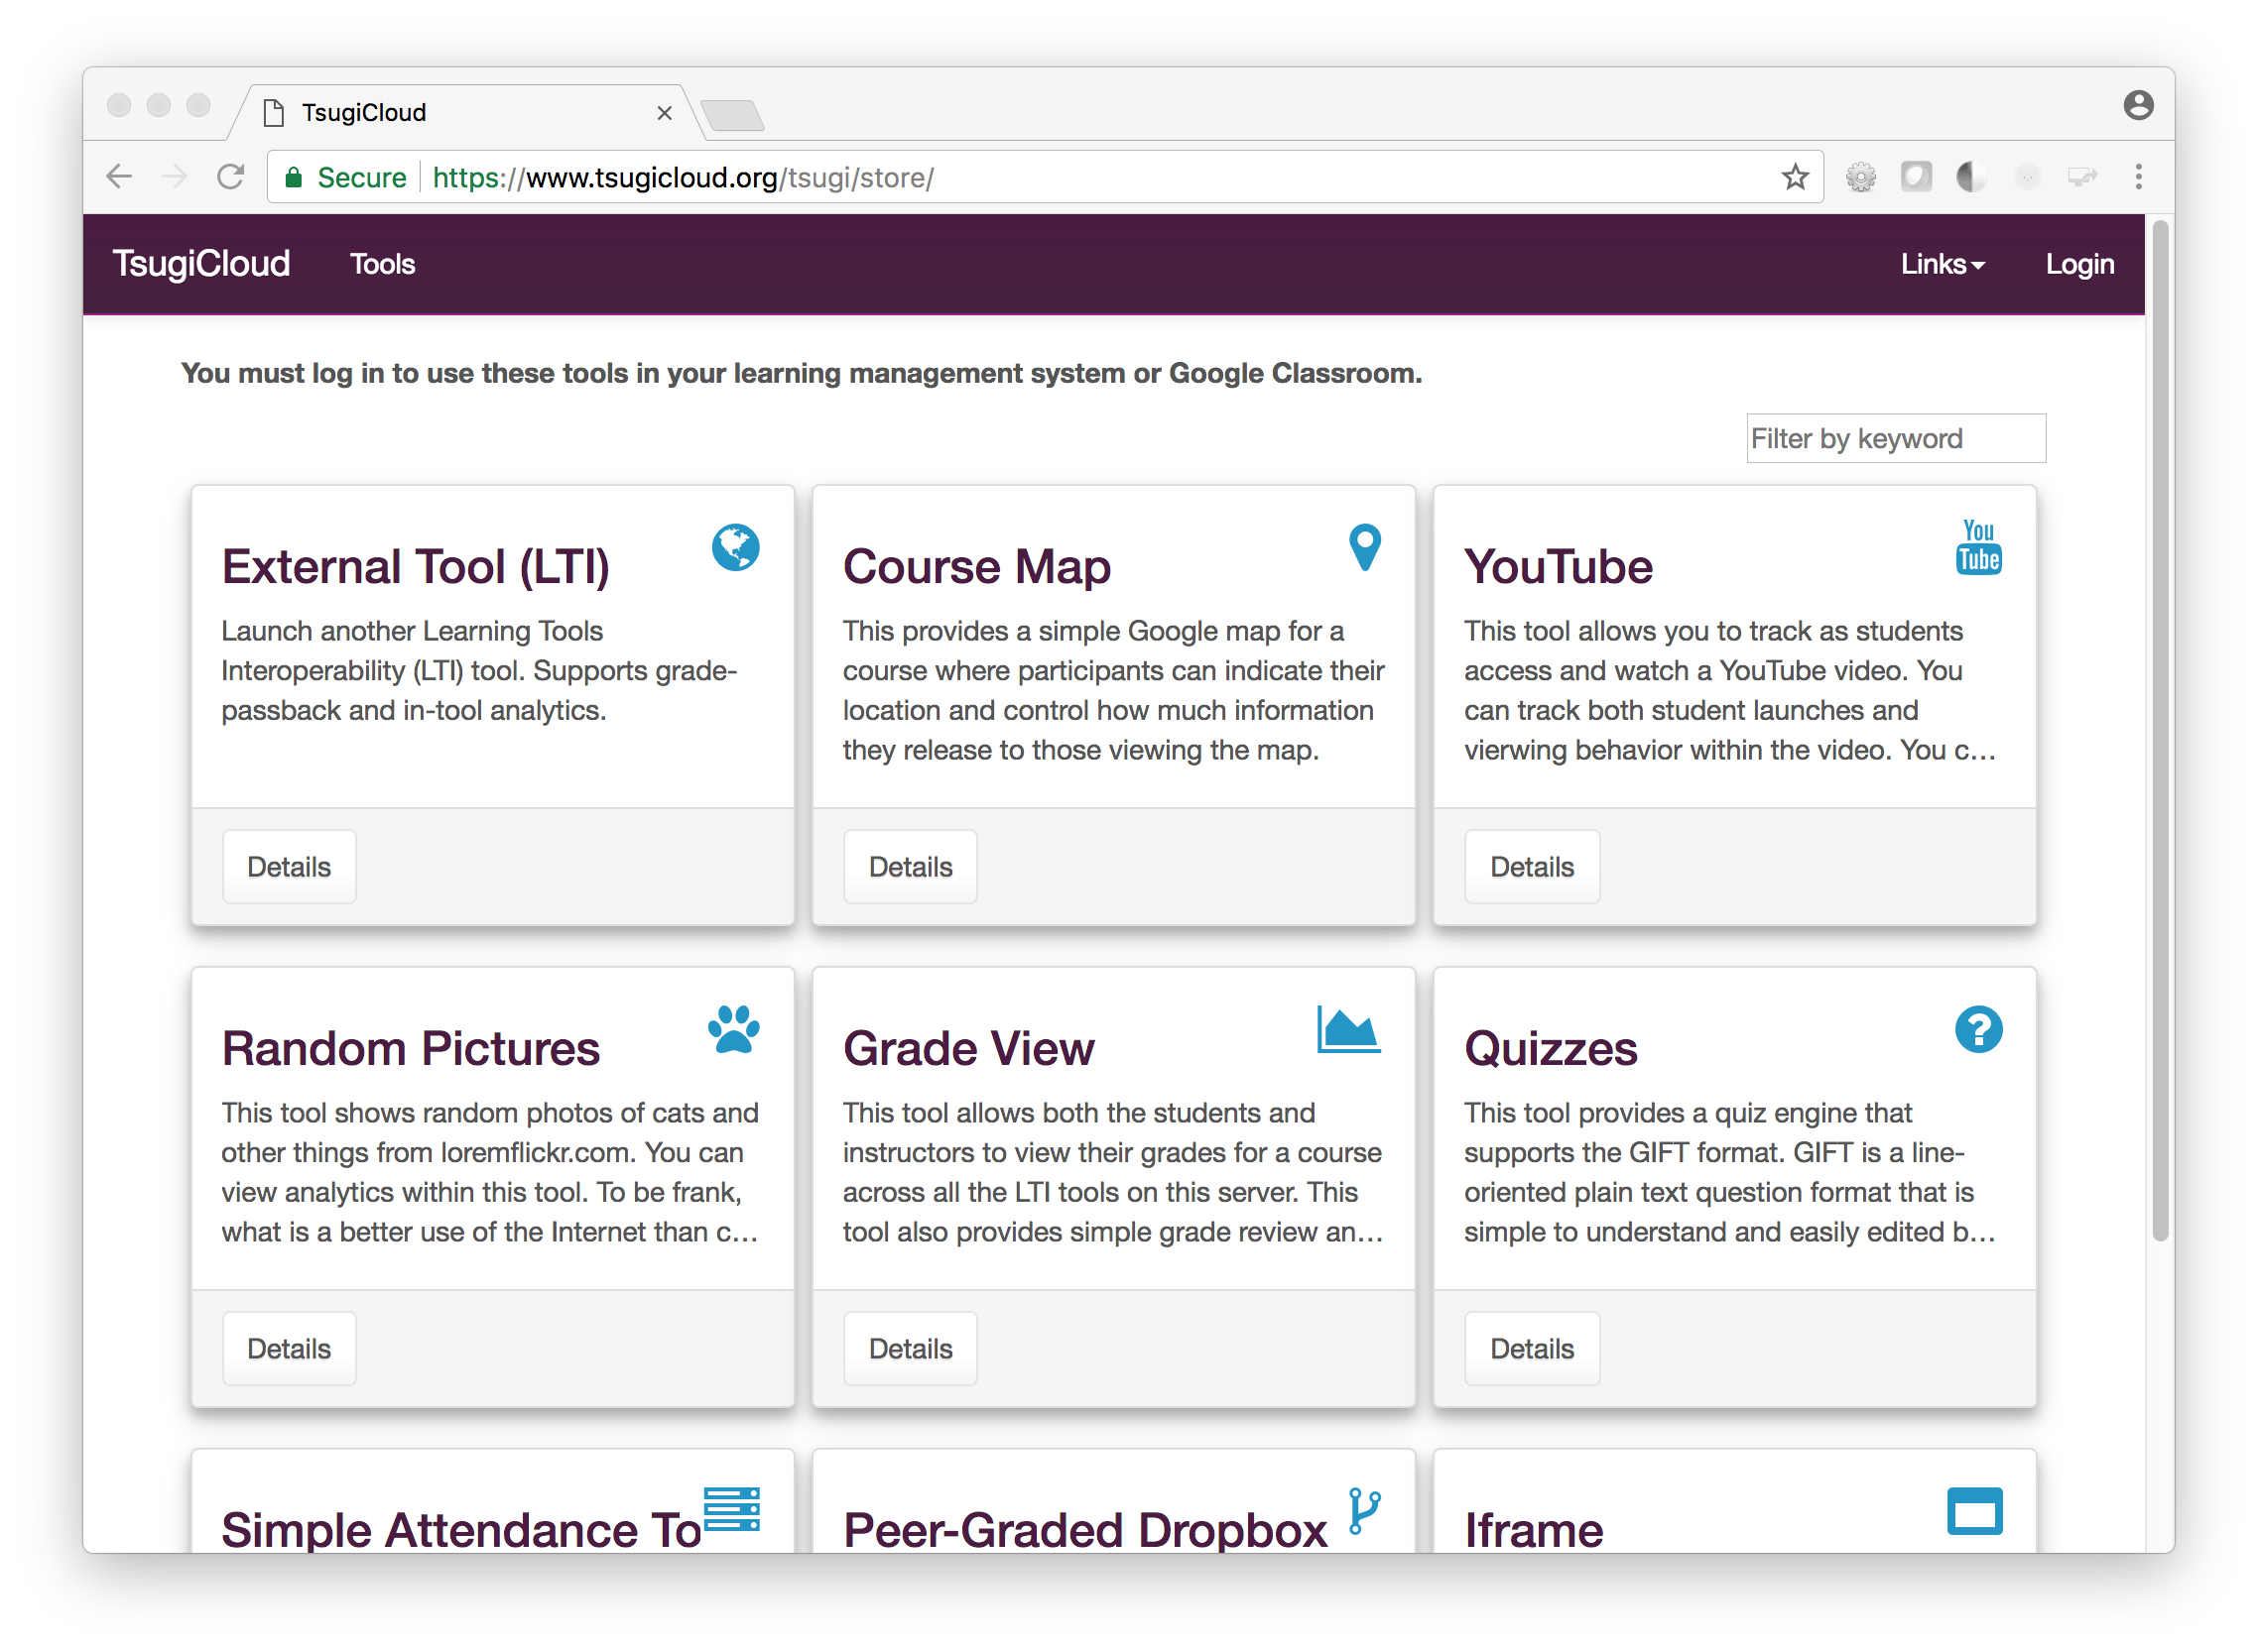
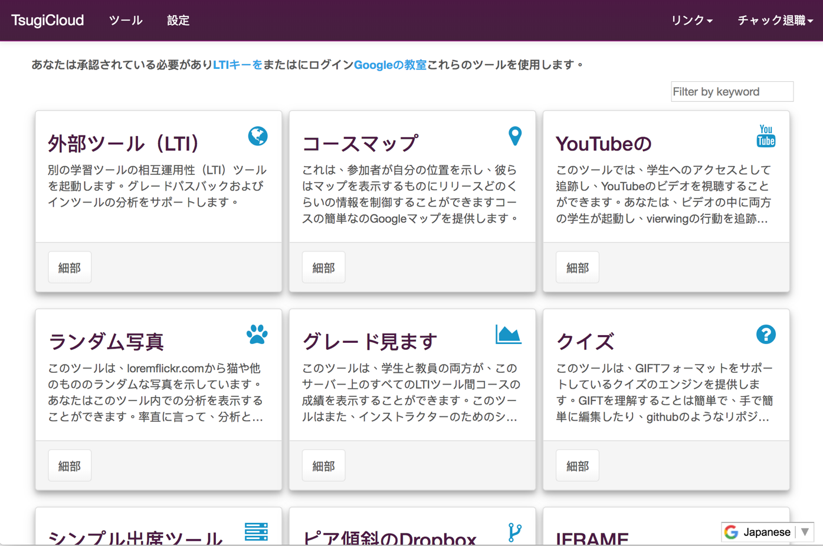

Slide 17
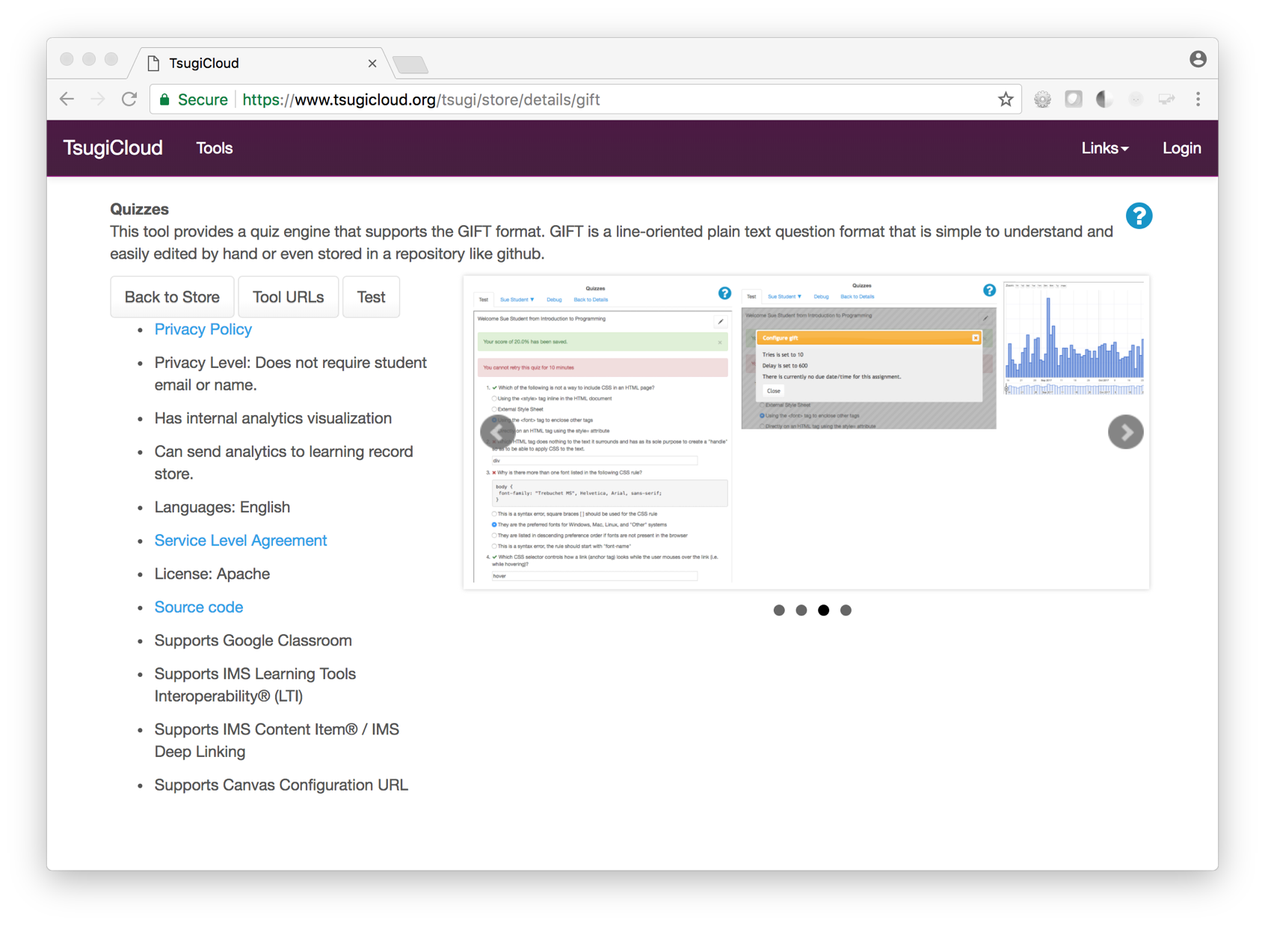
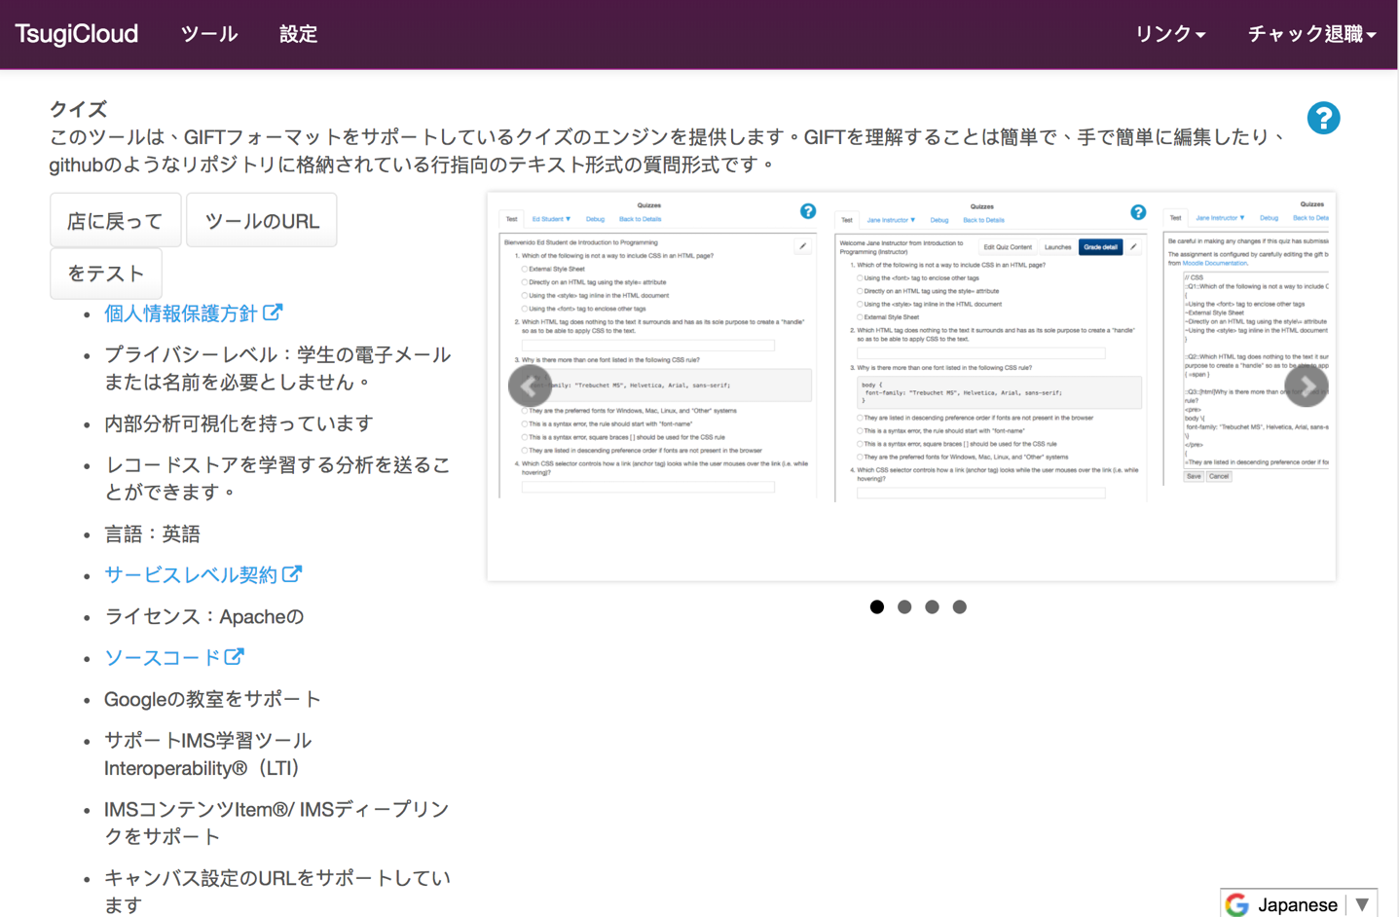

Slide 18
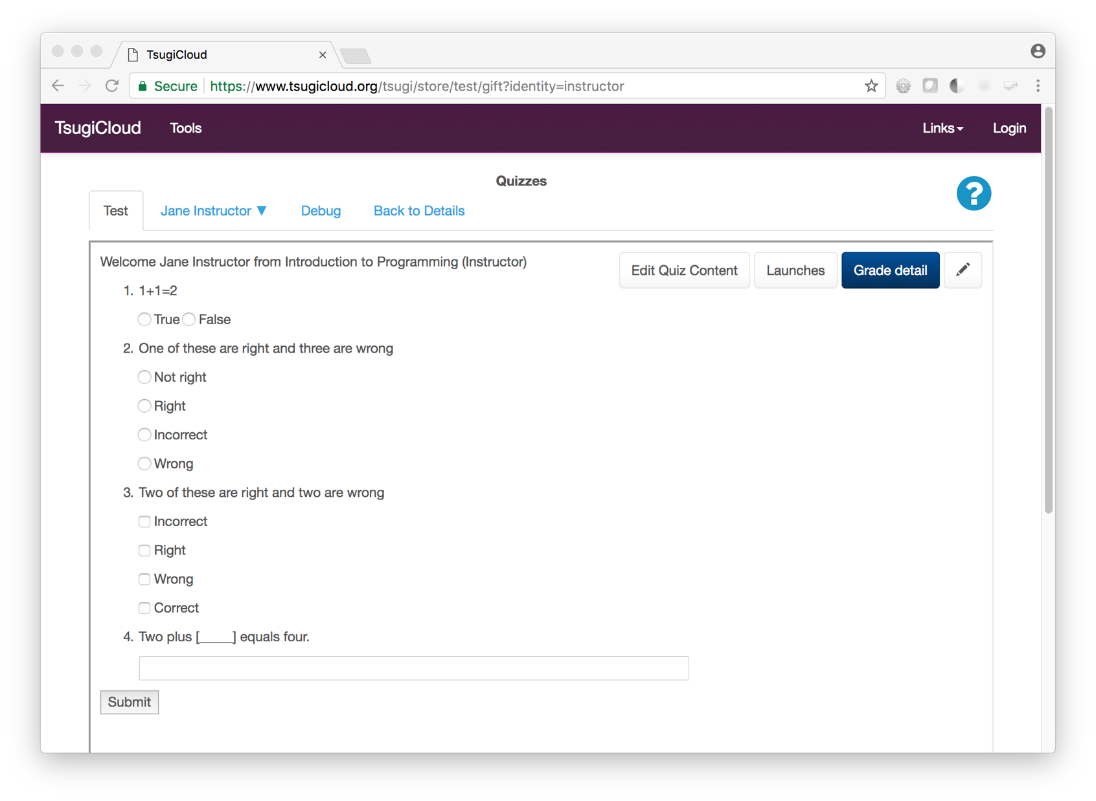
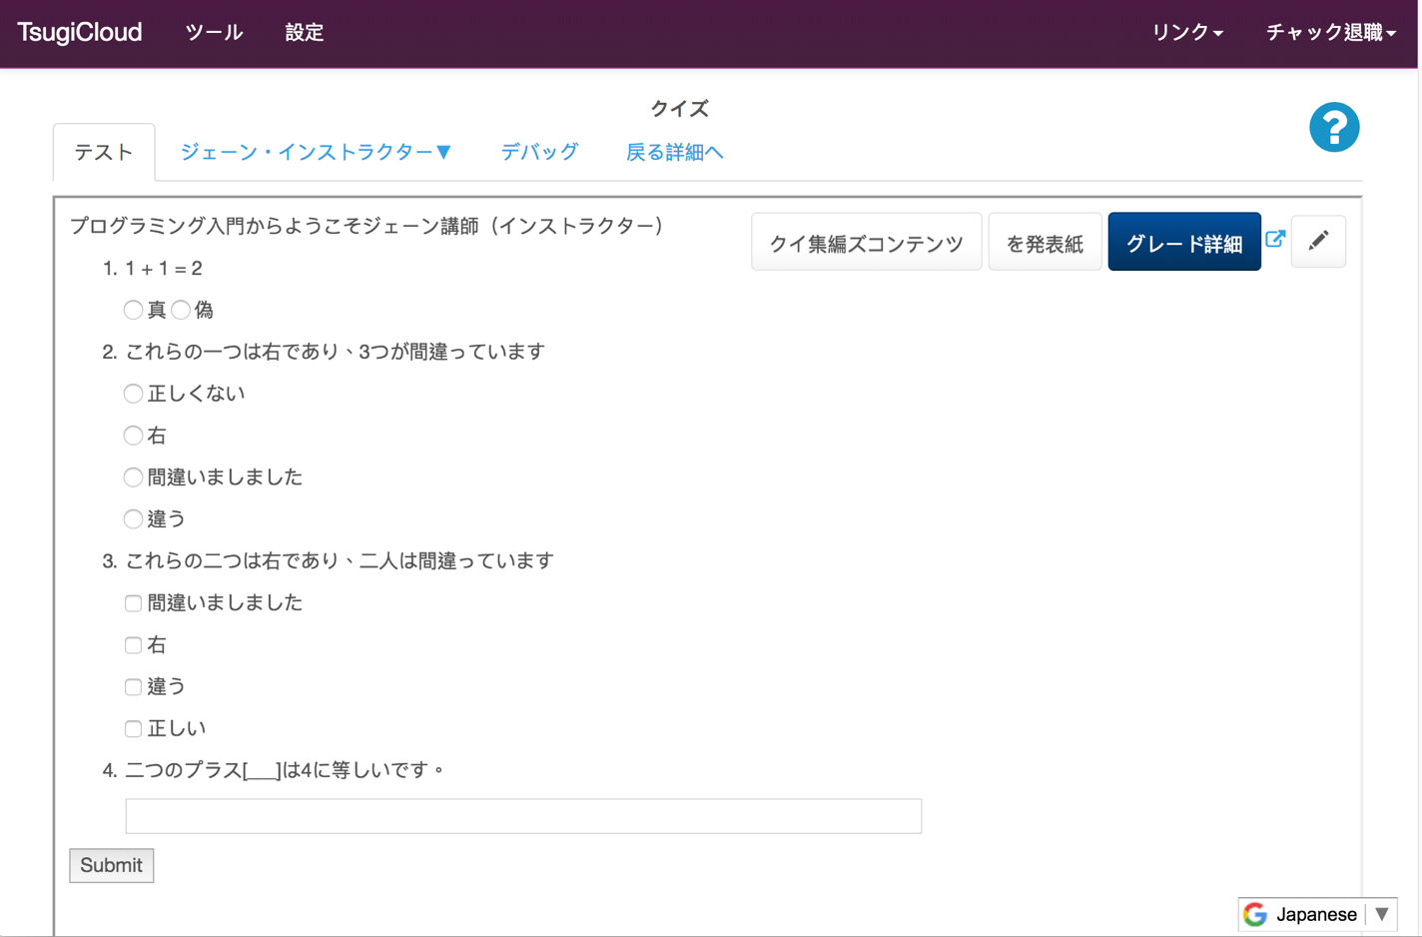

Slide 19
Amazon Architecture
Beta
cloud-01
Aurora
Database
Cloudflare
CDN
Amazon
Load Balancer
cloud-02
Elastic File
System (EFS)
…
DynamoDB
TsugiCloud's Amazon Setup is Open Source

Slide 20

Building Tsugi Learning Apps

Slide 21
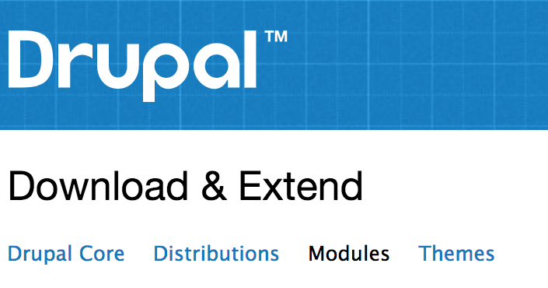

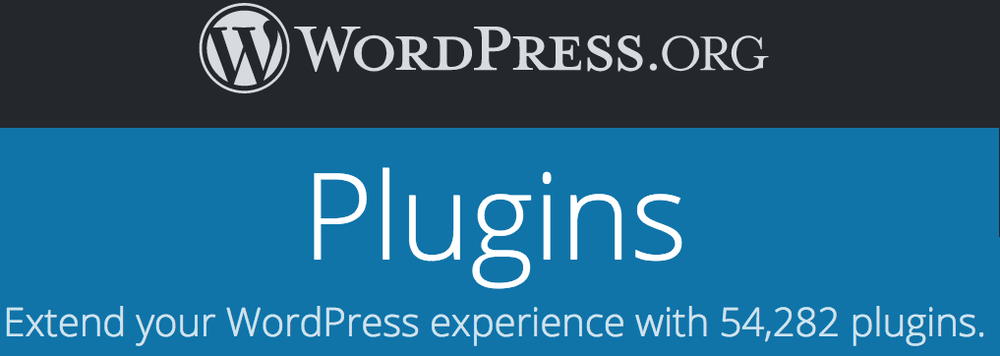


Slide 22
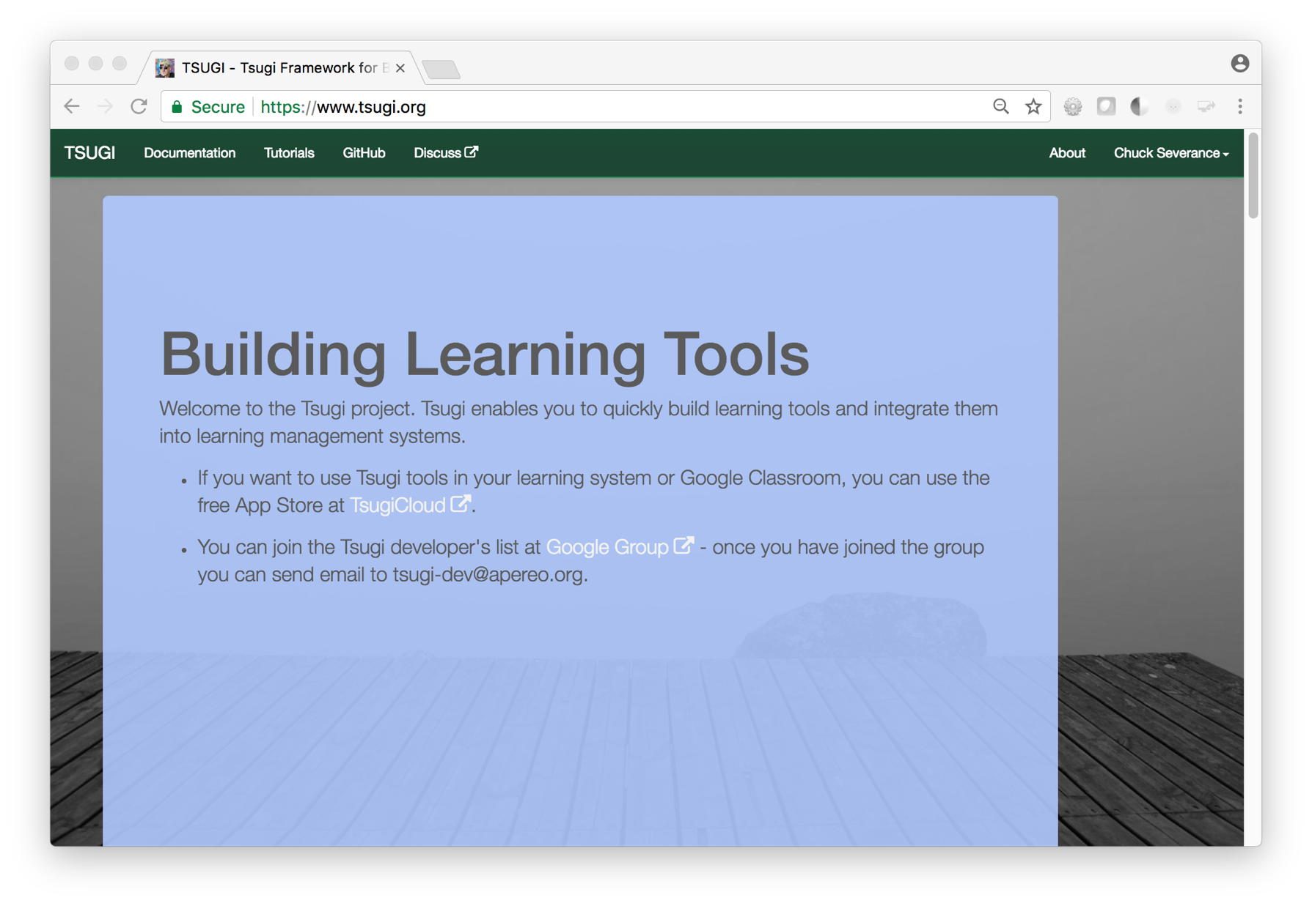
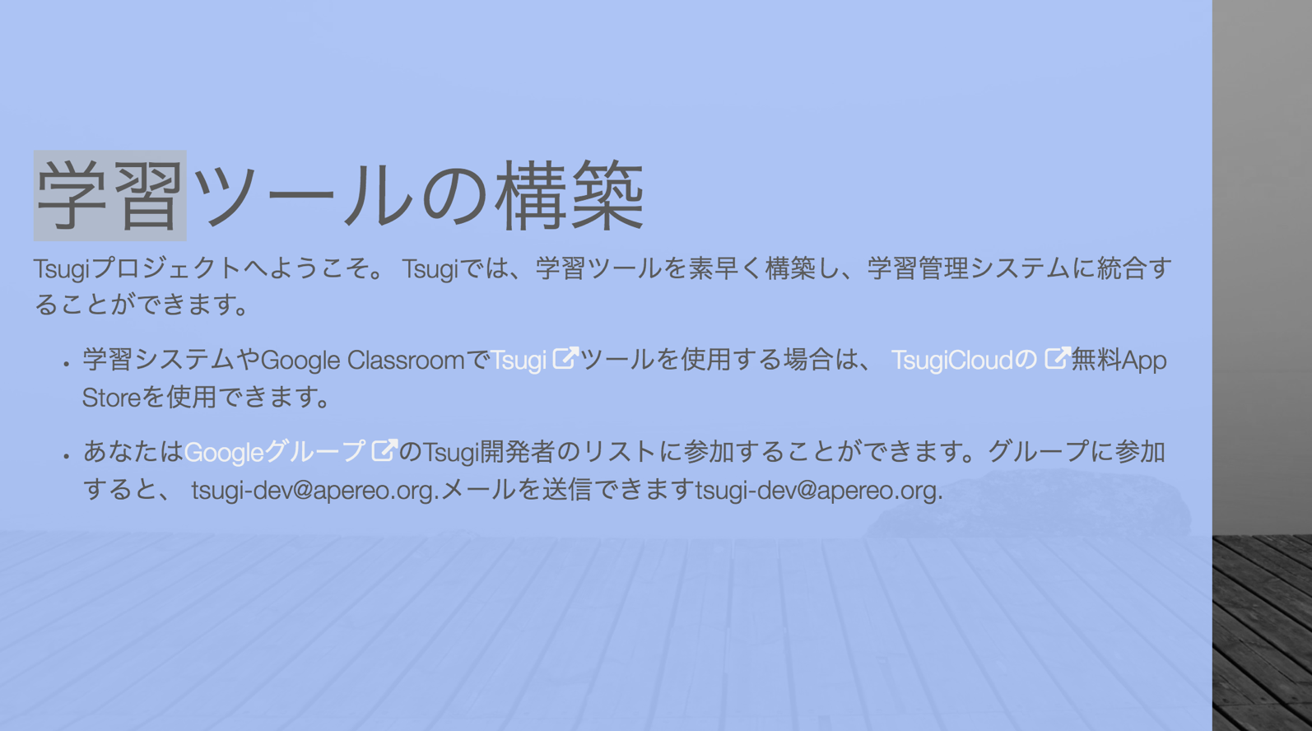

Slide 23
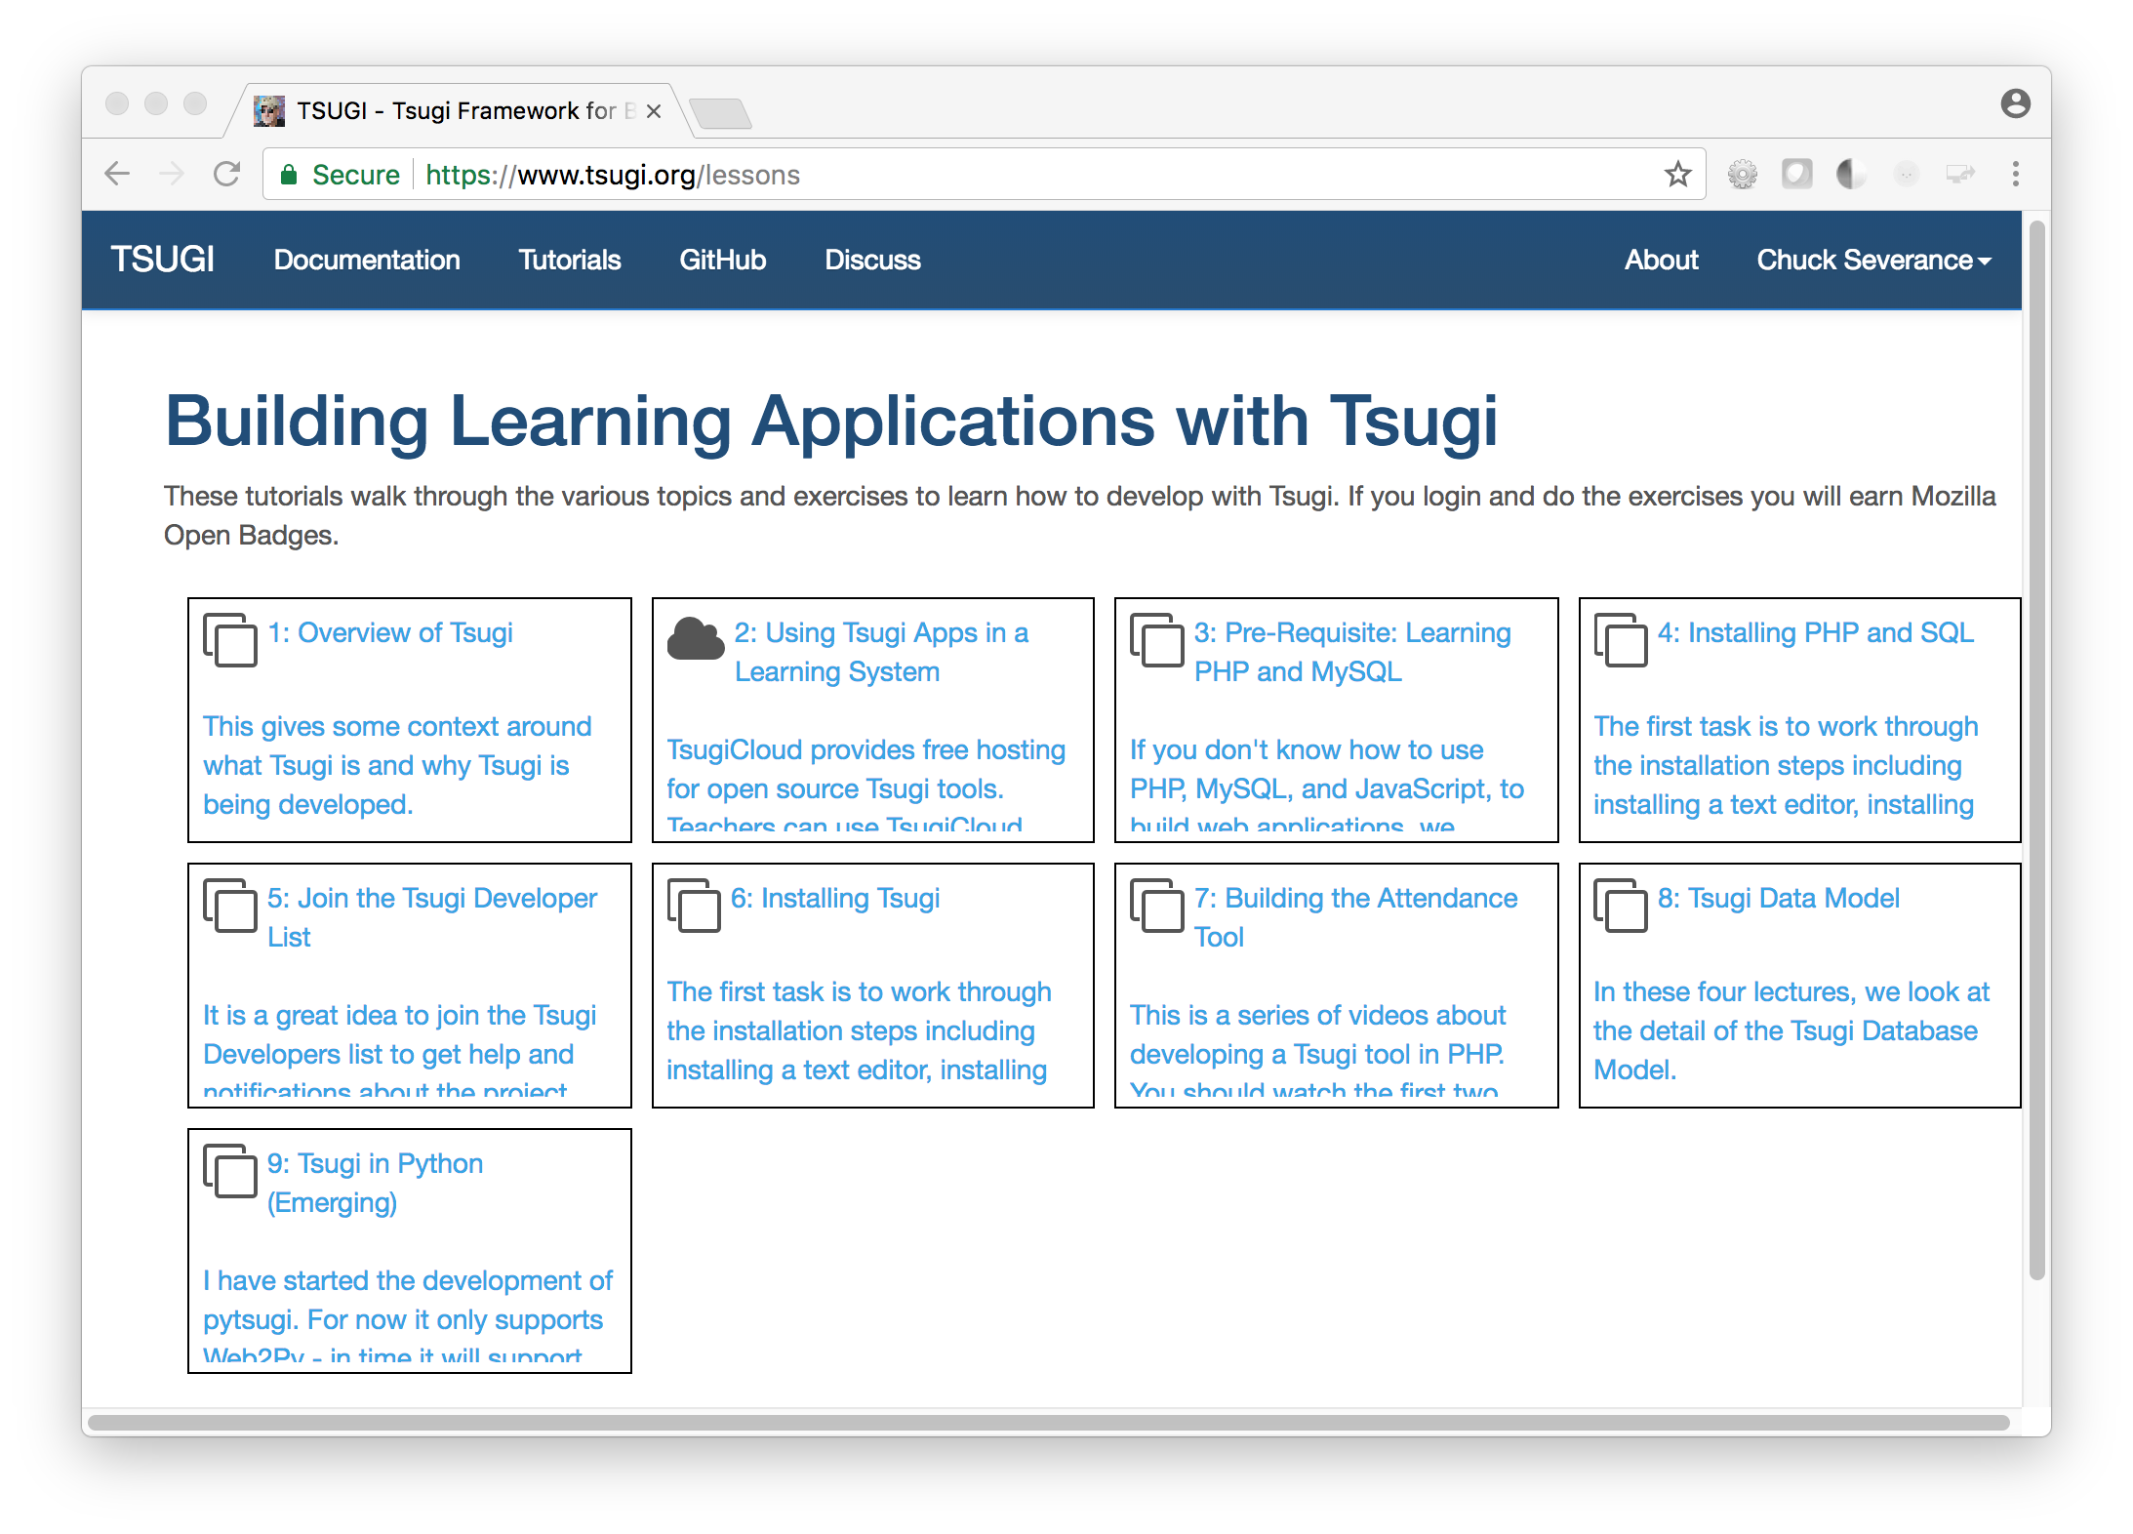
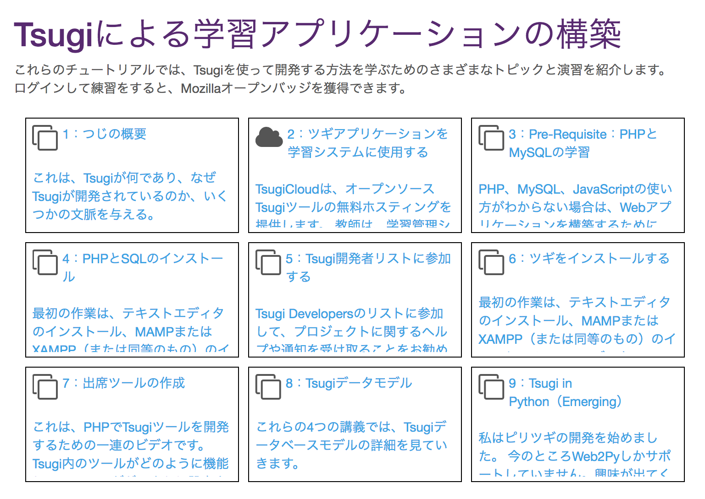

Slide 24
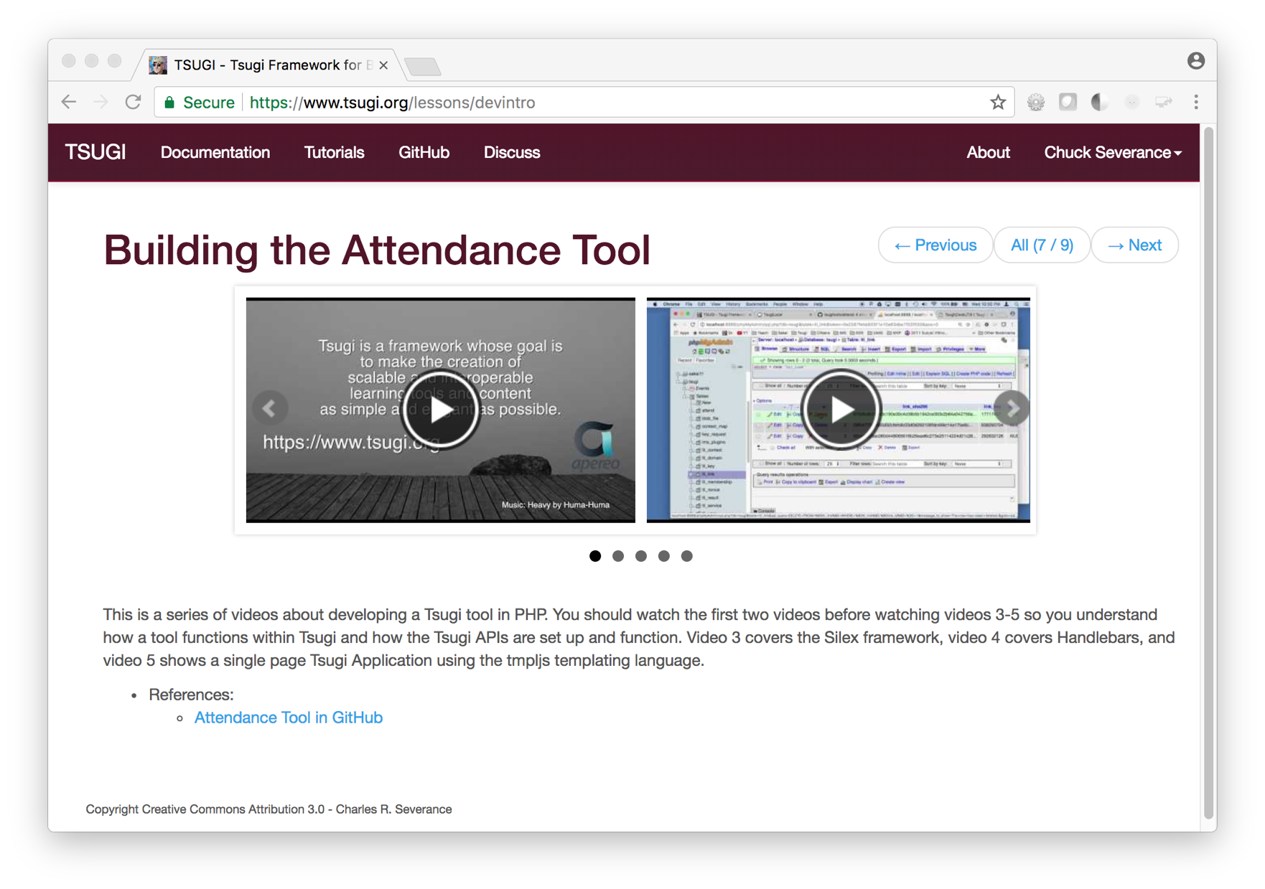
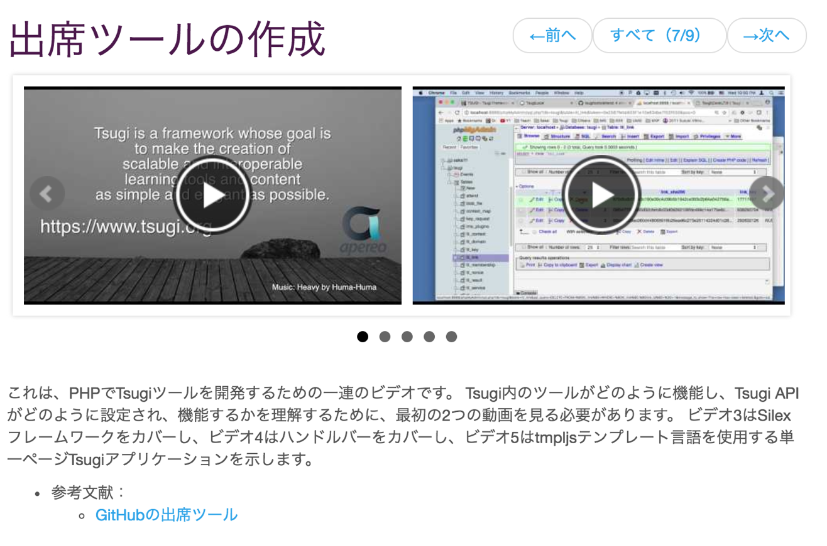

Slide 25
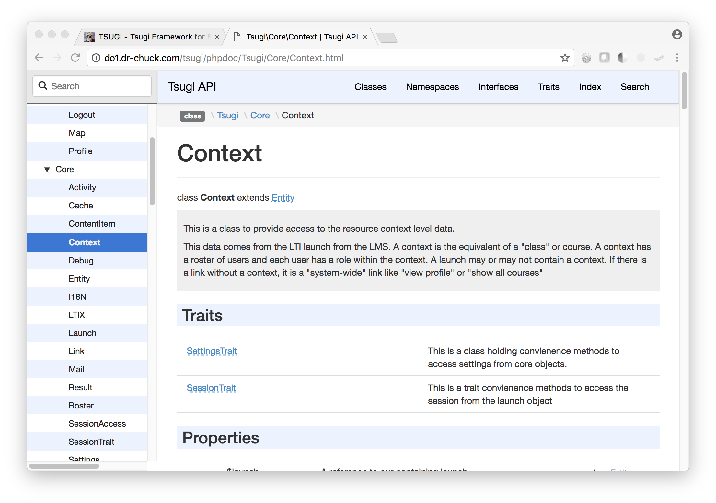
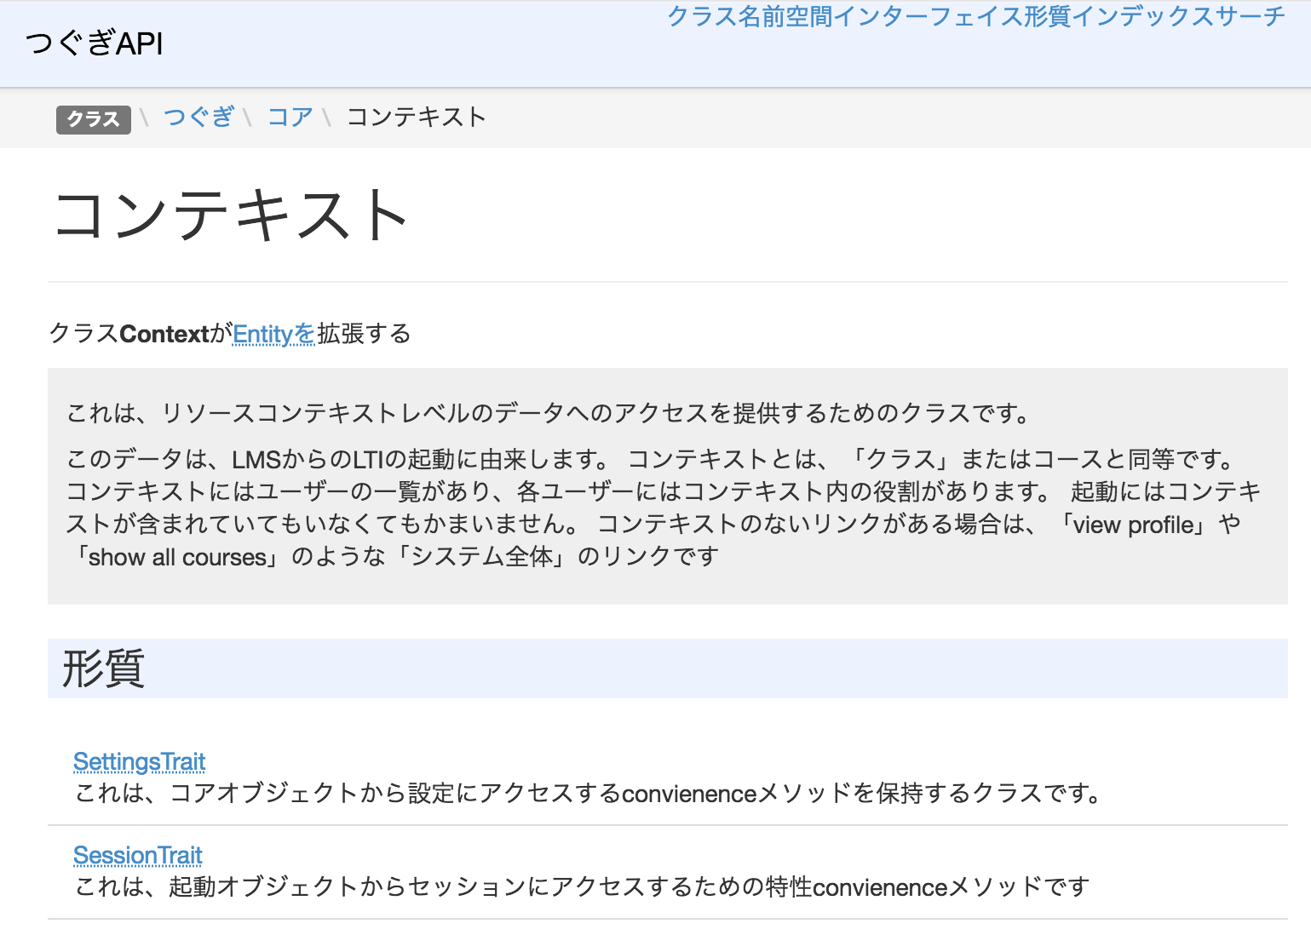

Slide 26
Tsugi APIs
Tsugi App
Adapted App
Any App
UI/UX APIs
Look / Feel
UI Widgets
Opinionated APIs
Convention / Database Model / Session
Easy for App Developer to Use
Utility APIs
Implement Standards
Portable / Resuable outside Tsugi

Slide 27
Tsugi Standards Support
IMS Learning Tools Interoperability 1.0, 1.1, 2.0, 2.1 (draft)
IMS Deep Linking
IMS Common Cartridge
Google Classroom OAuth 2.0 (Proprietary)
Caliper (somewhat)
xAPI (somewhat)

Slide 28





Active Tsugi Developers
Notes:
Duke

Slide 29
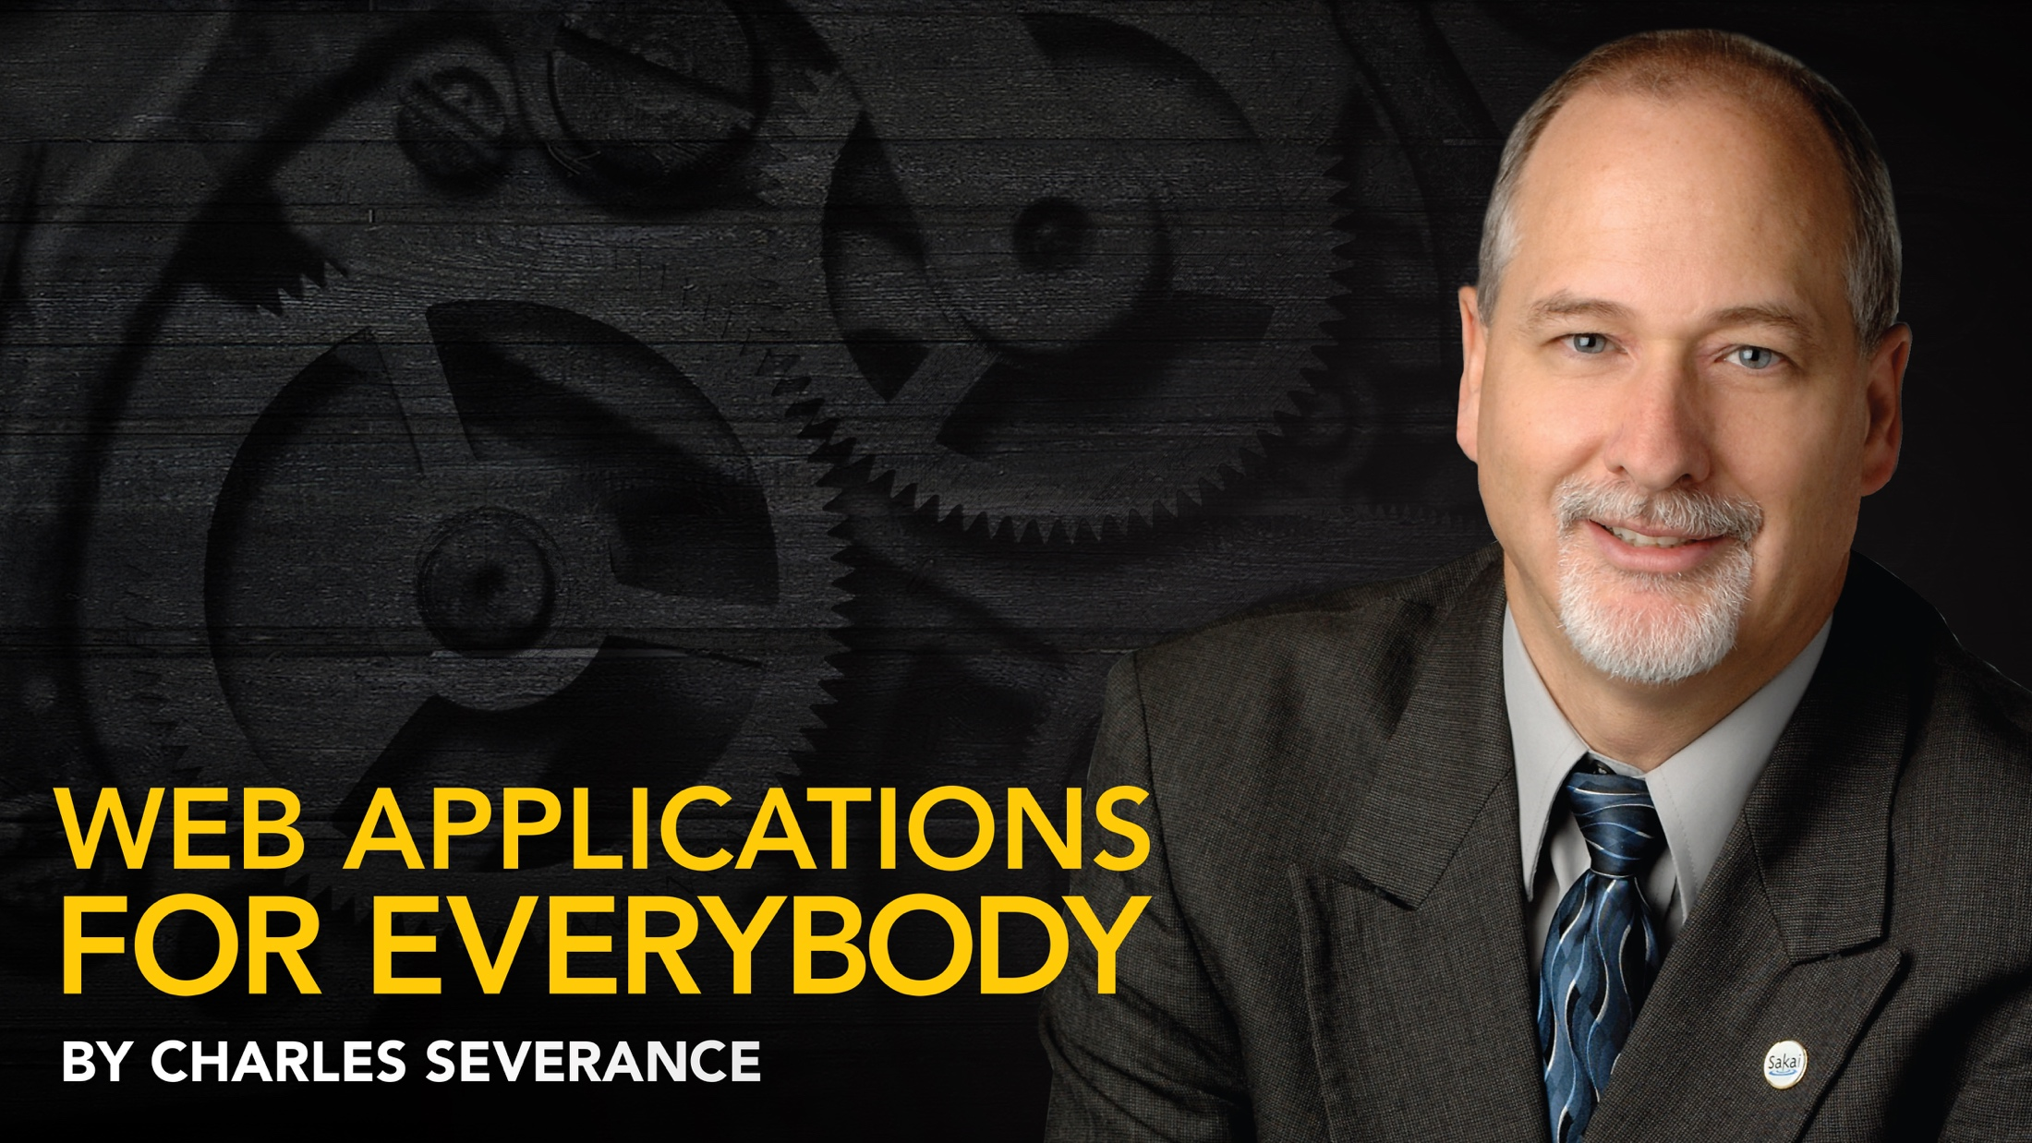
Any Questions? www.tsugi.org www.tsugicloud.org

Slide 30
Demo (time permitting)

Slide 31
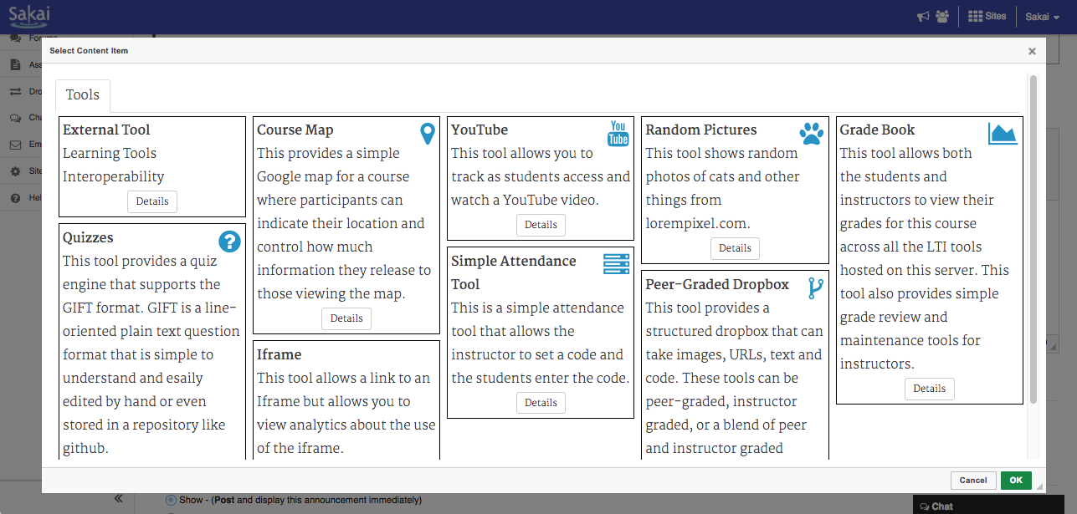

Slide 32
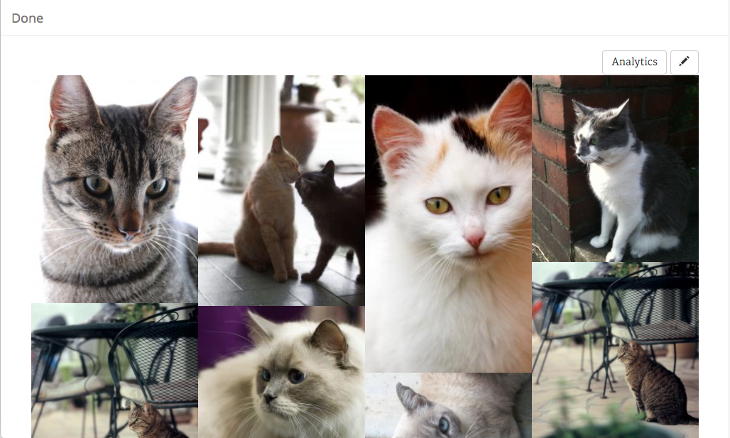

Slide 33
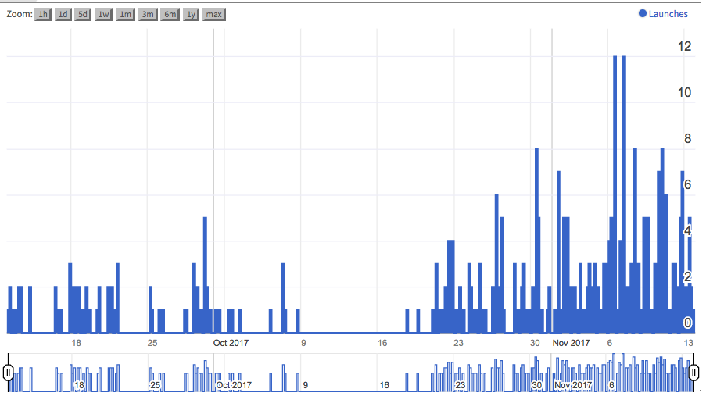

Slide 34
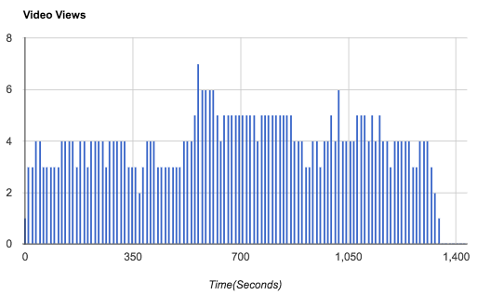

Slide 35
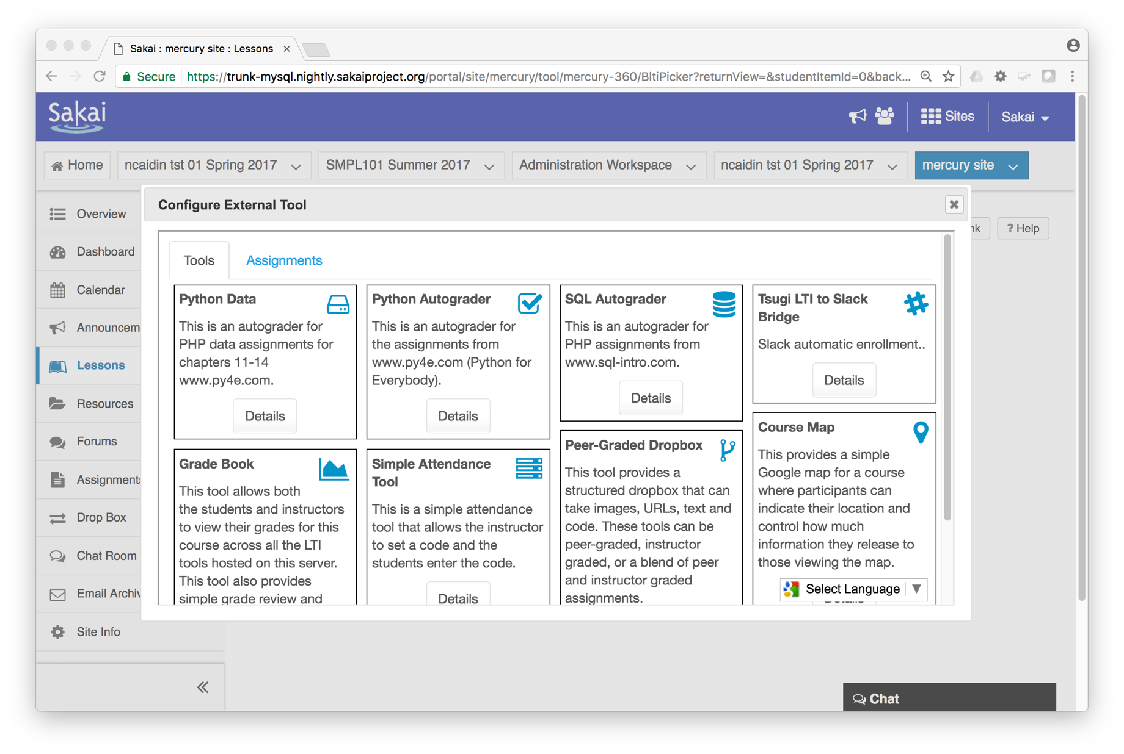

Slide 36
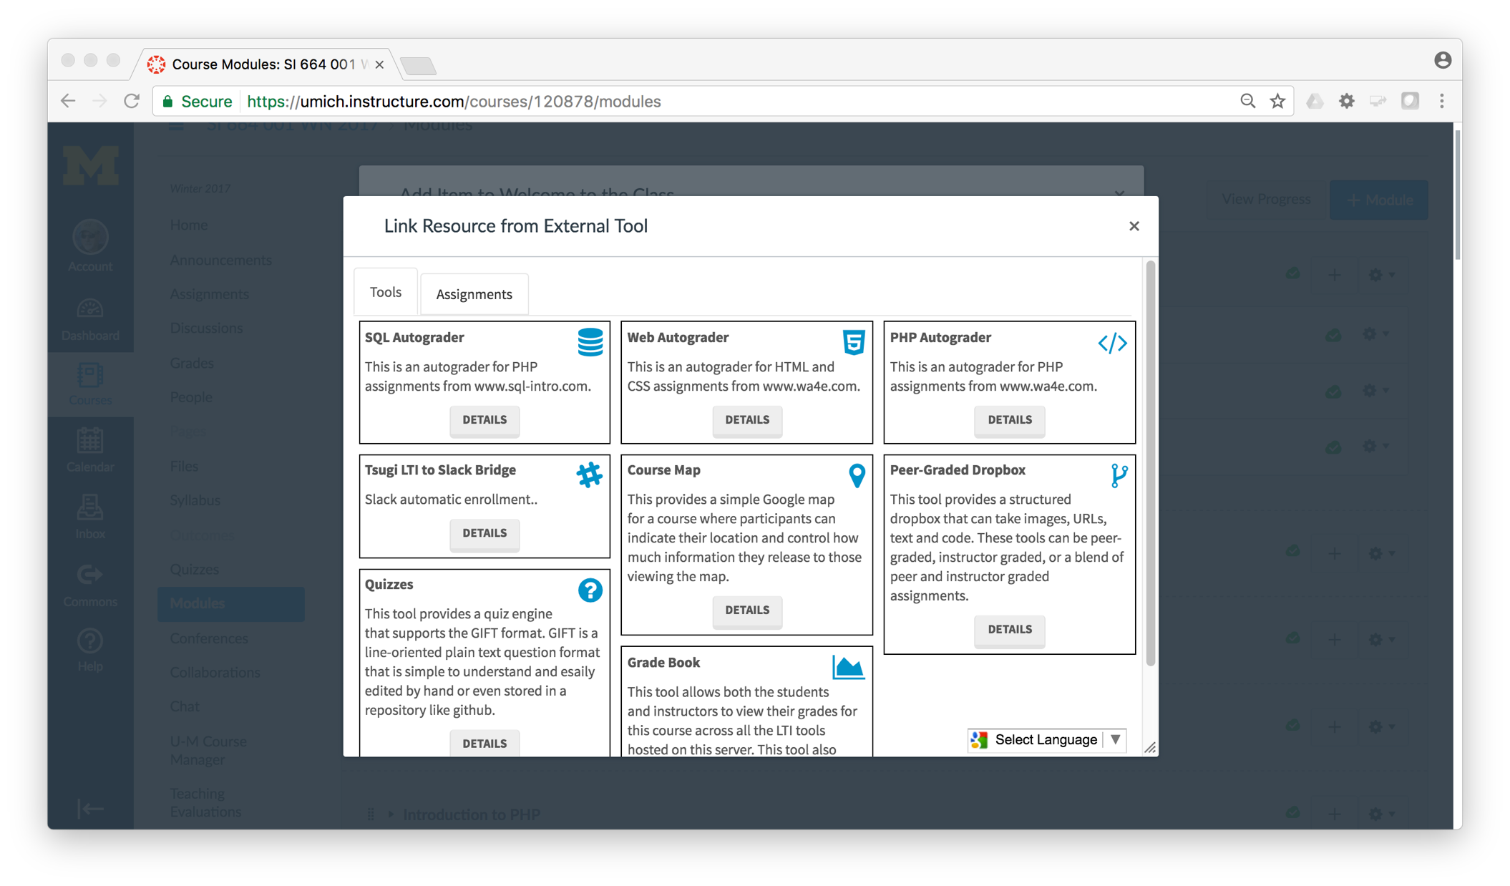

Slide 37
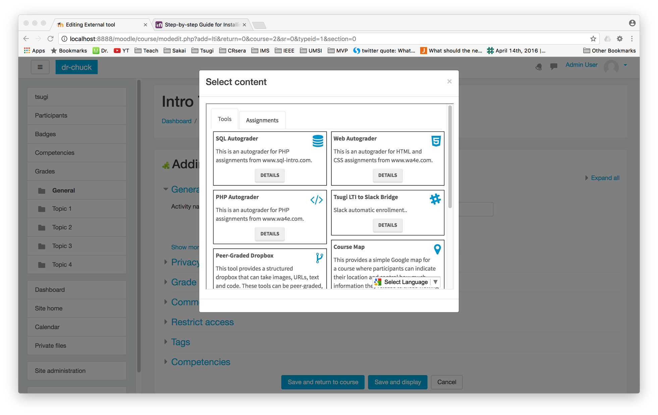

Slide 38
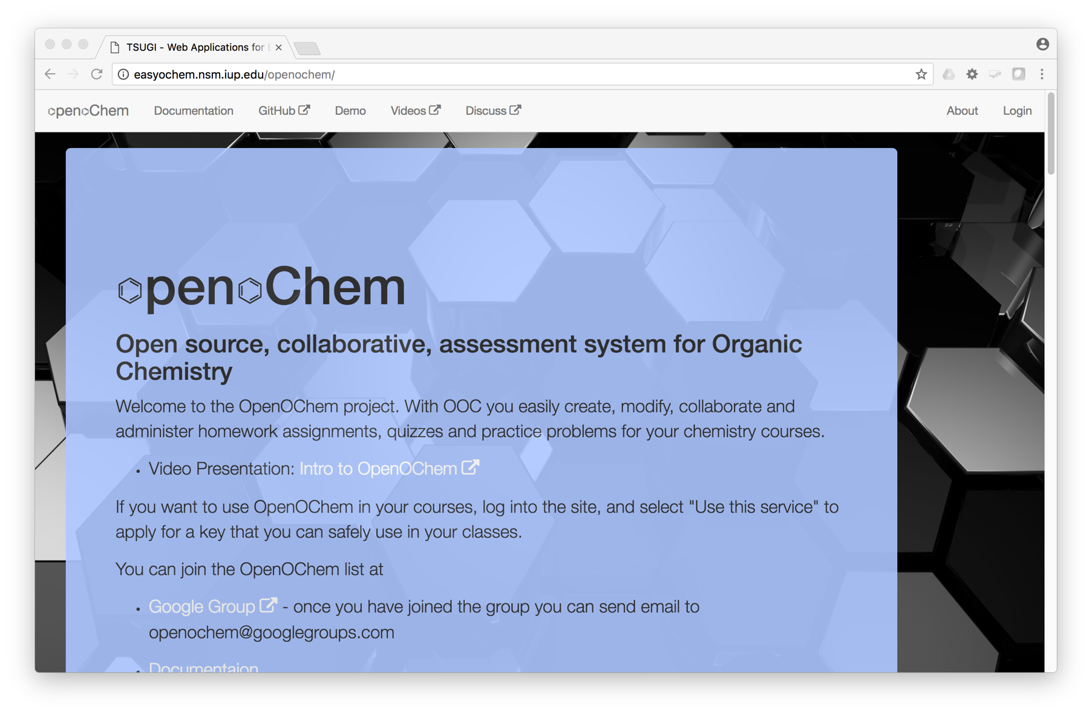
Carl LeBlond, Indiana University of Pennsylvania

Slide 39
Topics
Educational App Store
API Libraries
"Lego Blocks"
Interoperability
New tools that *teach*
EdTech startups made easy
Training / Documentation
Enrich Open Educational Content
Seamless Content Integration and Reuse (LOR)
Stand-Alone MOOC platform
LMS based on Tsugi technology
koseu.org (코스)

